Slide 1

KIGALI COLLEGE
DEPARTMENT: EEE
PROGRAM: BACHELOR OF TECHNOLOGY IN ELECTRONICS AND TELECOMMUNICATION
TECHNOLOGY MODULE CODE: GENML801
MODULE NAME: MACHINE LEARNING
REG NUMBER:25RP18714
DATE: October 09, 2025
Project:
Crop Recommendation System Using Machine Learning Based on Soil and Environmental Parameters

Slide 2
Problem Statement
Farmers often struggle to decide which crop to grow due to multiple factors like soil nutrients, pH, rainfall, and temperature. Without scientific tools, wrong choices can lead to poor yields, wasted resources, and soil damage.

Slide 3
Project Goal
To develop a machine learning model that recommends the most suitable crop for given soil and weather conditions, helping farmers make informed decisions and improve productivity.

Slide 4
Data Understanding
Dataset includes: Nitrogen (N), Phosphorus (P), Potassium (K), pH, temperature, humidity, and rainfall.
Target: Crop label (22 crop types).
Goal: Understand relationships and distributions among features.

Slide 5
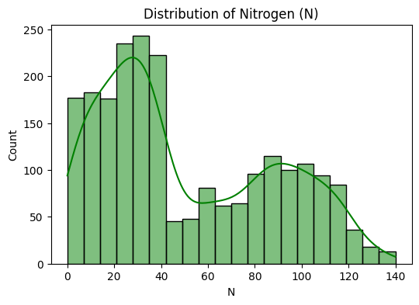
Univariate Analysis - Nitrogen (N)
This histogram shows the distribution of Nitrogen values across samples.
Observation: Most values fall between 0–50, but some reach up to 140.
Helps identify skewness and potential outliers.

Slide 6
Bivariate Analysis - Rainfall vs Crop
This boxplot compares rainfall requirements across different crops.
Observation: Rice and papaya require high rainfall, while pulses like mothbeans grow in drier conditions.

Slide 7
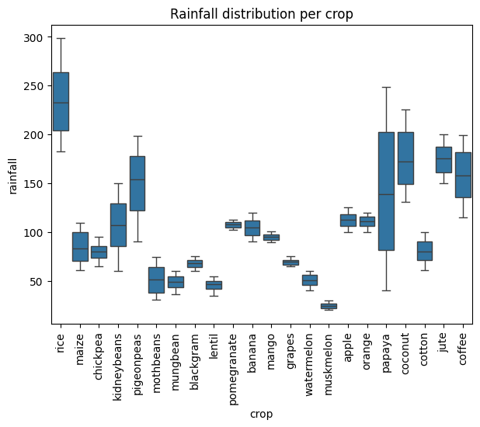
Bivariate Analysis - Rainfall vs Crop

Slide 8
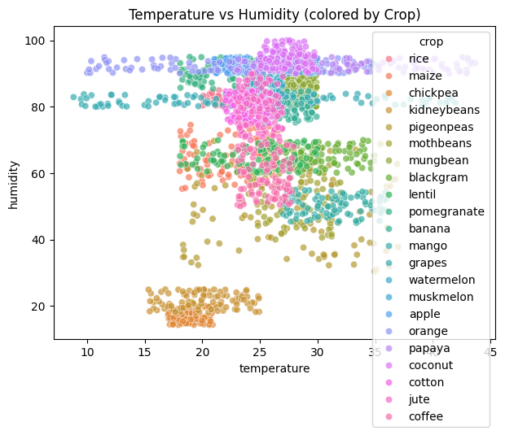
Scatter plot (Temperature VS Humidity)

Slide 9
Data Cleaning
• Removed impossible values (e.g., humidity >100%, negative nutrients)
• Handled missing values using mean imputation
• Detected and treated outliers using capping and transformations

Slide 10
Feature Engineering
Label encoding for crops
Normalization and standardization applied to ensure equal scale
Feature selection based on correlation and importance scores

Slide 11
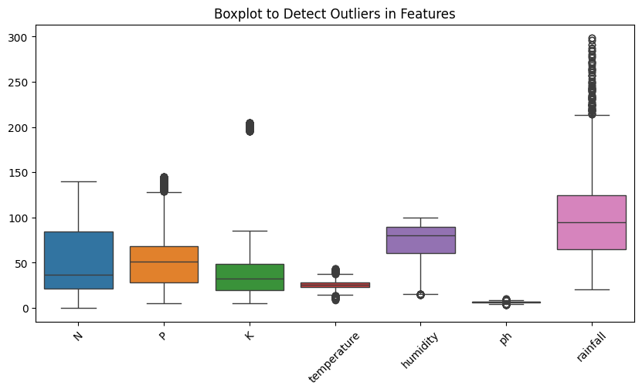
Detecting outliers

Slide 12
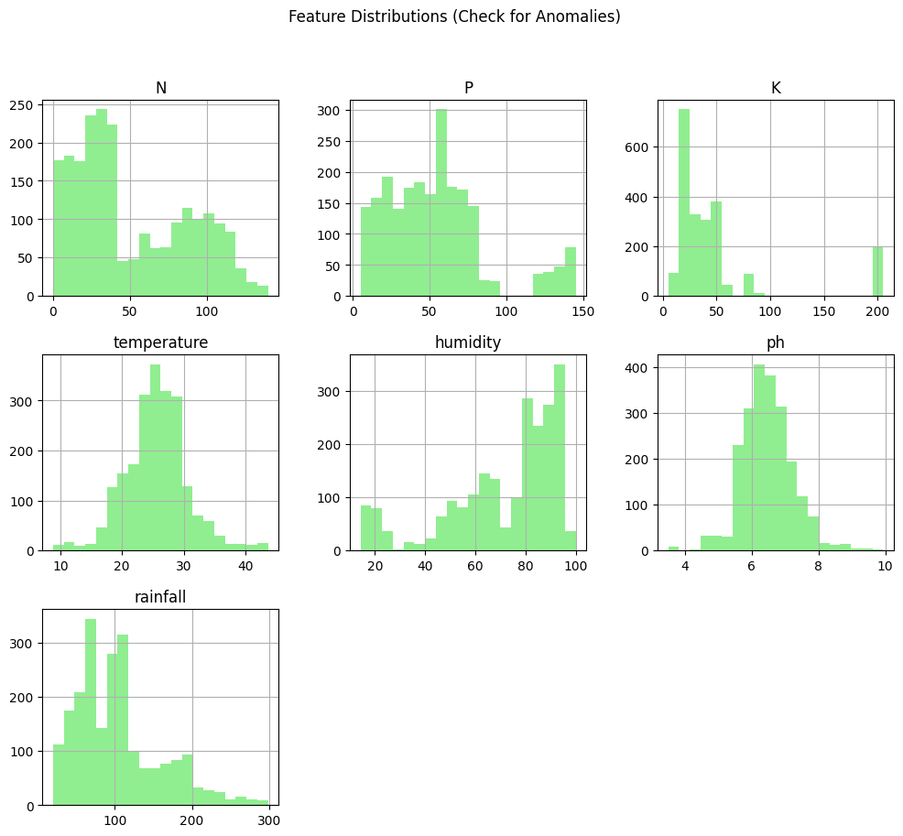
Data anomalies

Slide 13
Feature Extraction - PCA
Principal Component Analysis (PCA) reduced 7 numerical features into fewer components.
Helps visualize data trends and improve computational efficiency.

Slide 14
Model and Crop Recommendation
Trained ML model (e.g., Random Forest or Decision Tree) predicts best crop based on given conditions.
As I trained my model by using Random forest.
Output: Recommended crop with confidence score.

Slide 15
Conclusion
✔ Data cleaning and feature engineering improve model accuracy.
✔ ML-based crop recommendation system enables data-driven decisions.
✔ Supports sustainable agriculture and better yields.

